Slide 1



S I K I I P
Sistem Informasi Karyawan Idea Imaji Persada

Slide 2
TIM:
Miftahul Firdaus
Adinda Virguinia
Sulaiman Osman
Nurma Syanti

Slide 3
Fitur
Profil
Form Izin
Kontak Karyawan
Gaji
Data Karyawan
Presensi
Penggajian
Divisi
Persetujuan Izin

Slide 4
Thank You

Slide 5
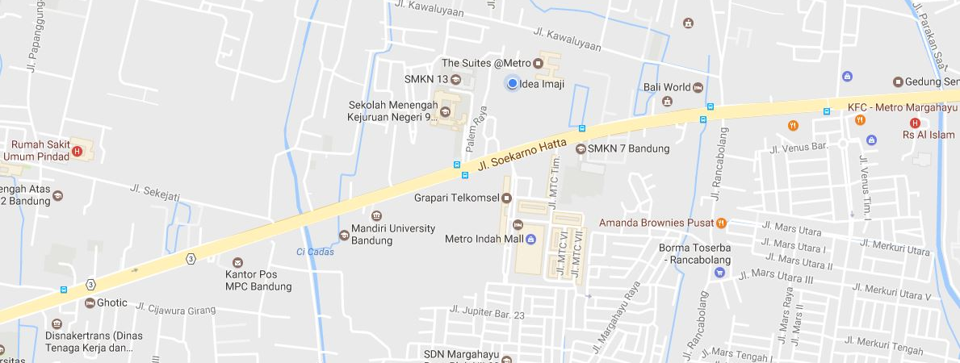
Idea Imaji
Parahyangan Business Park Blok D No. 3
The Suite Metro, Jl. Soekarno Hatta 689B Bandung 40286
Contact Us
Bandung
Phone
Parahyangan Business Park Blok D No. 3
The Suite Metro, Jl. Soekarno Hatta 689B
Bandung 40286
+62 22 87793157
contact@ideaimaji.com
Whether you’re looking for answers, would like to solve a problem, or just want to let us know how we did, you’ll find many ways to contact us right here.
Jakarta
Jl. Tirtasari No. D/2 Utan Kayu
Matraman
Jakarta Timur 13120
Find Me Now

